Slide 1
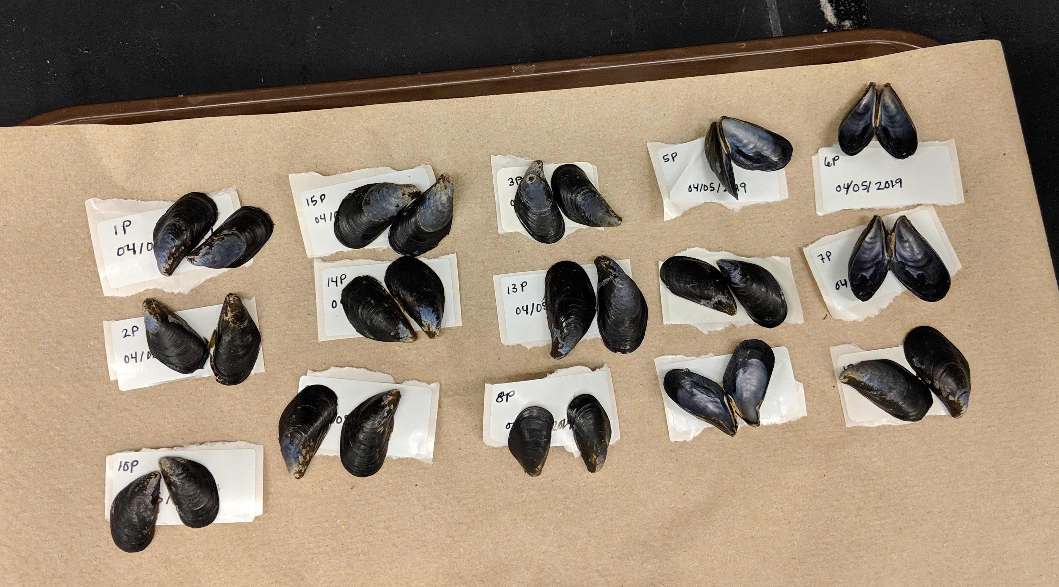
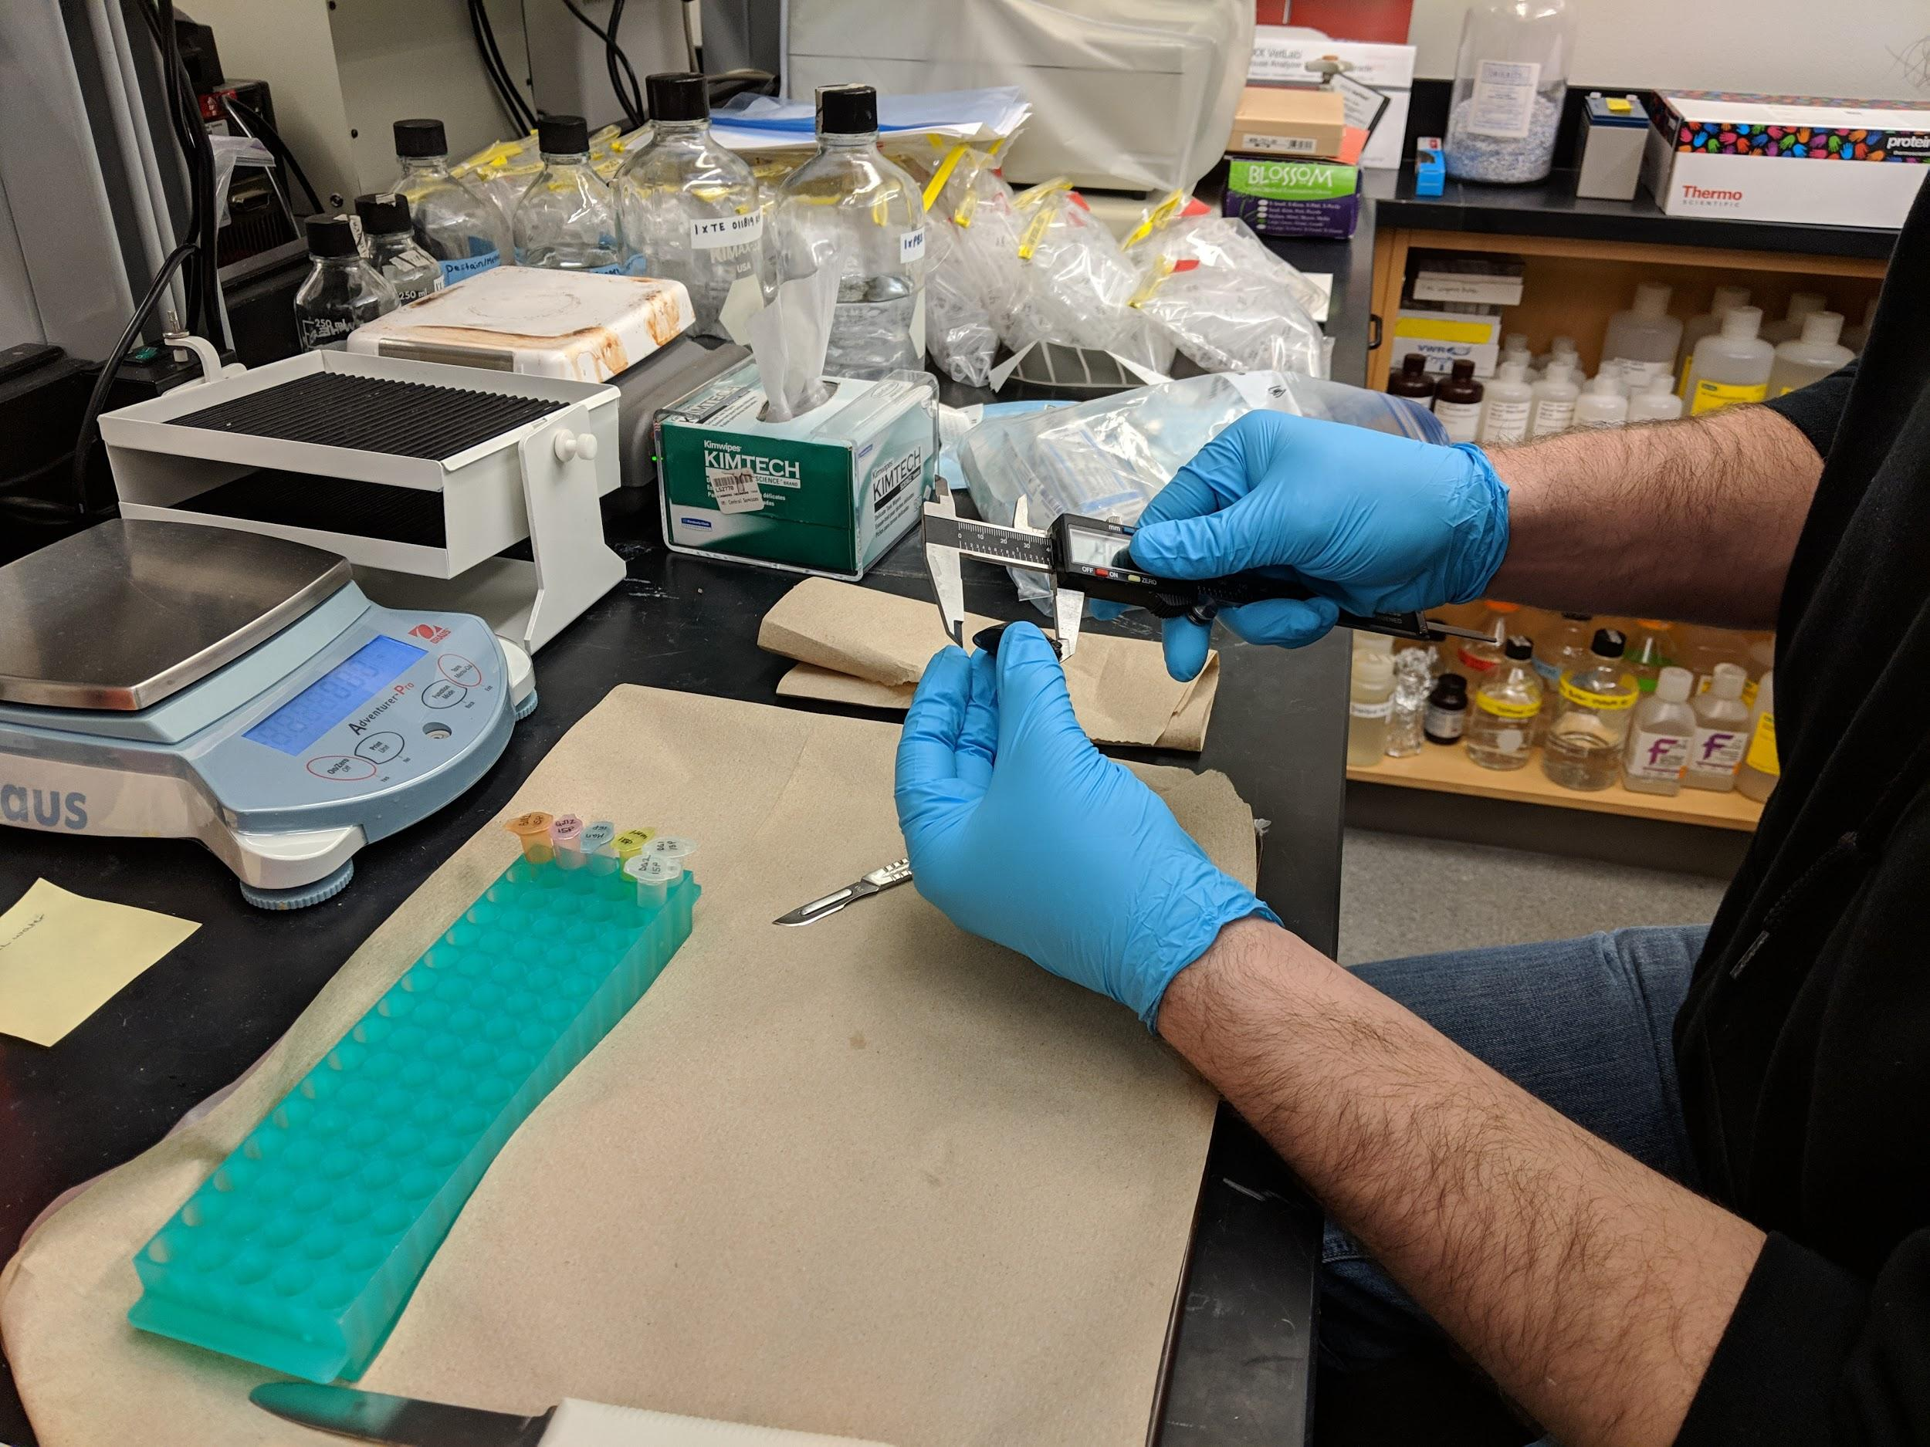

ADAC Year 8 Annual Meeting
ADAC Project Briefing
“Photo-enhanced toxicity of dispersed and burned crude oil to Arctic mussels.”
Patrick Tomco, Ph.D
Department of Chemistry
University of Alaska Anchorage

Slide 2
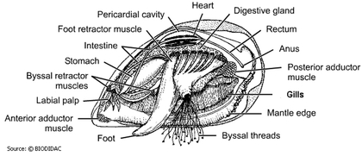
Photo-enhanced toxicity of dispersed and burned crude oil to Arctic mussels
ADAC Program Year 8 Annual Meeting
Project Principal Investigator:
Patrick Tomco, Ph.D
University of Alaska Anchorage
Supporting Team:
Colin McGill, Ph.D, UAA
Katrina Counihan, Ph.D, Alaska Sealife Center
Phoebe Zito, Ph.D, University of New Orleans
Student Participation:
Kevin Fitzpatrick, Anastasia Hanson, and Cameron Carlson
Project Champion:
LTCR Clifton Graham

Slide 3
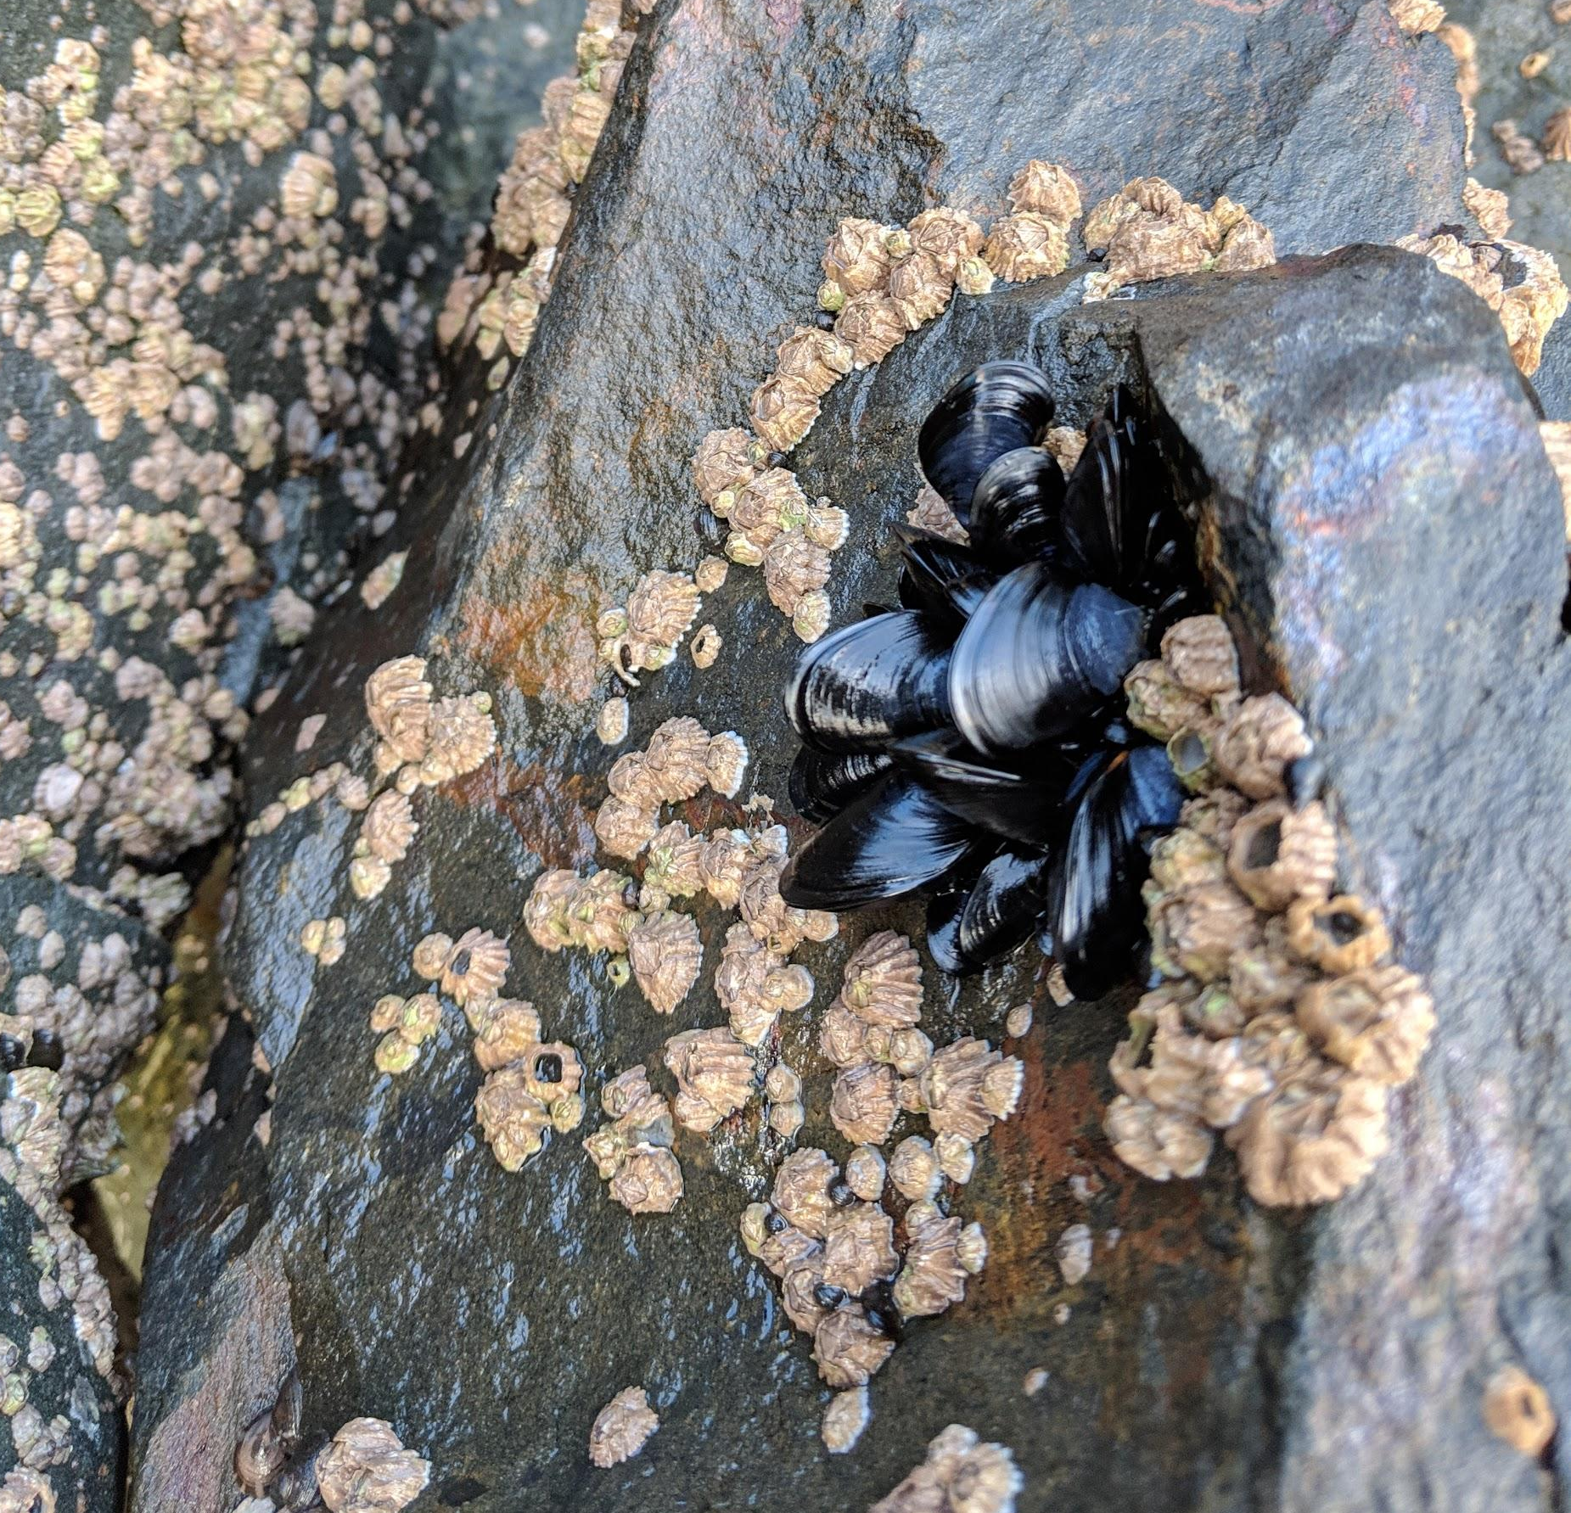
Photo-enhanced toxicity of dispersed and burned crude oil to arctic mussels: Description and Baseline
ADAC Program Year 8 Annual Meeting
Project assesses the impact burned vs dispersed crude oil has on marine life and if seasonal sunlight differences change the efficacy of either recovery method.
The toxicity of dispersed or burned oil to marine organisms can differ from untreated oil
Photo-enhanced toxicity (i.e. the increase in toxicity associated with the presence of sunlight) of crude oil is documented
The toxicological impacts of dispersed vs. burned crude oil exposure in the presence/absence of sunlight toward Arctic mussels have never been assessed in the extreme environmental conditions of the Arctic.

Slide 4
Source: National Academy of Sciences, 2014

Slide 5
Photo-enhanced toxicity of dispersed and burned crude oil to arctic mussels: Relevance
ADAC Program Year 8 Annual Meeting
Relevance to DHS and USCG
Results can be applied to management decisions on the use of recovery methods
A set of knowledge products useful for USCG to apply to a spill response scenario

Slide 6
ADAC Program Year 8 Annual Meeting
Photo-enhanced toxicity of dispersed and
burned crude oil to arctic mussels: Research Objectives
Objective 1: Exposure Experiments
    Conduct static exposure tests with bay mussels in seawater with oil, Corexit 9500, oil dispersed with Corexit 9500, and oil subjected to in-situ burn with three different photoperiods.
Objective 2: Physiological/Biochemical Assays
    Assess physiological and biochemical responses of bay mussels to the oil, dispersant, and in-situ burned oil in the exposure tests at different time points.
Objective 3: Metabolomics
    Evaluate metabolic health of mussels in the exposure tests using metabolomics.
Objective 4: Chemical Analysis
    Profile the chemical constituencies of oil, dispersed oil, and burned oil treatments used in the mussel exposures and how each treatment chemically weathers throughout the experiment.
Objectives incorporated as Phases into timeline

Slide 7
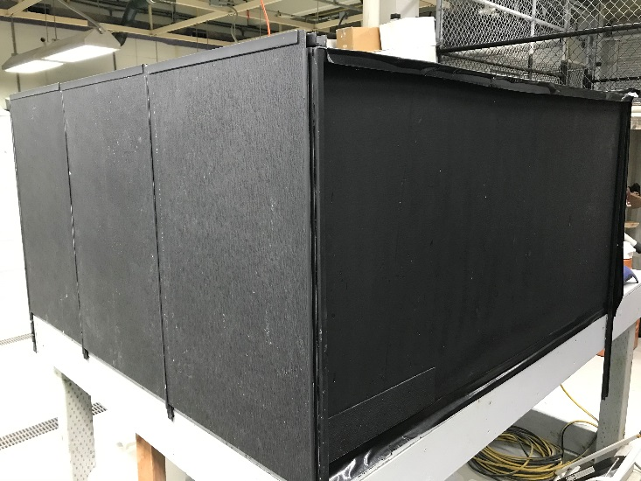
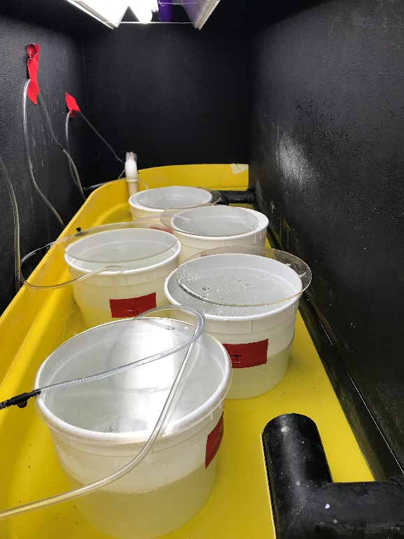
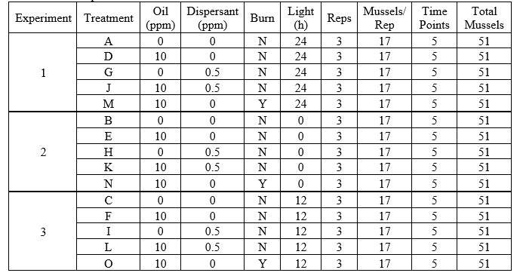
ADAC Program Year 8 Annual Meeting
Progress in meeting research methods:
(Completed Phase 1)
Phase 1 steps:
1. Construct Exposure apparatus
2. Collect Mytilus trossulus from Resurrection Bay
3. Conduct laboratory-based exposure.
  Three exposures completed in September, October, and November

Slide 8
ADAC Program Year 8 Annual Meeting
Milestones from Phase 1 (all complete):
  Team members participated in kick-off meeting with Project Champion
  Team member Counihan (ASLC) constructed exposure chambers in Seward, AK
  Mussels were harvested from Resurrection Bay, AK
  Mussels were acclimated in exposure chambers for 1-2 weeks
  Mussels were dosed with oil, dispersed oil, and burned oil under light and dark conditions.
  Mussels were harvested at 0, 1, 4, and 7 days post-treatment
  Mussels were dissected and tissues archived for Phase 2 and 3
  Water samples were collected and mailed to Team member Zito (UNO).

Slide 9
ADAC Program Year 8 Annual Meeting
Metrics for Phase 1 (all complete)
Metrics for Phase 1:
Task A: Obtain approved State of Alaska Department of Fish and Game aquatic resource permit for hand collection of Mytillus trossulus in Resurrection Bay
Task B: Obtain approved hazardous waste disposal and chemical safety approval.
Task C: Construct 15 exposure chambers. Each capable is suitable for safely containing 50 mussels in 5L seawater and containing oil in the event of a spill.
Task D: Collect >750 mussels from Resurrection Bay suitable for exposure assessment. Transport to exposure chambers.
Task E: Successfully acclimate test organisms to exposure chambers. Record data on mortality. Ensure 50 mussels per exposure chamber are acclimated.
Task F: Successfully collect burn residue from 3 small-scale controlled in-situ burns.
Task G: Expose collected mussels to 5 conditions: seawater, dispersant, oil, dispersed oil, and burned oil) under 3 light regiments. Organisms are harvested on the defined time intervals and dissected with the tissues archived, masses recorded, and recordings of mortality rates.
Completed
Completed
Completed
Completed
Completed
Completed
Completed

Slide 10
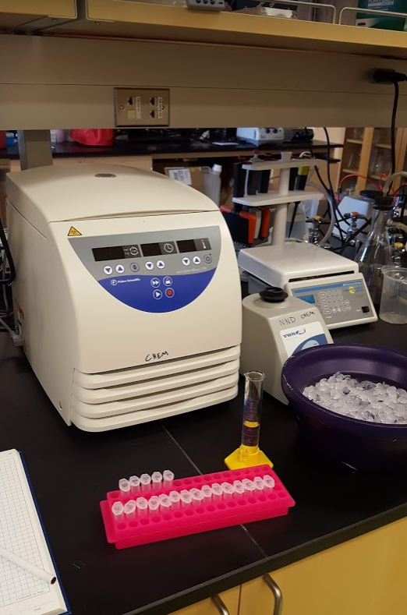
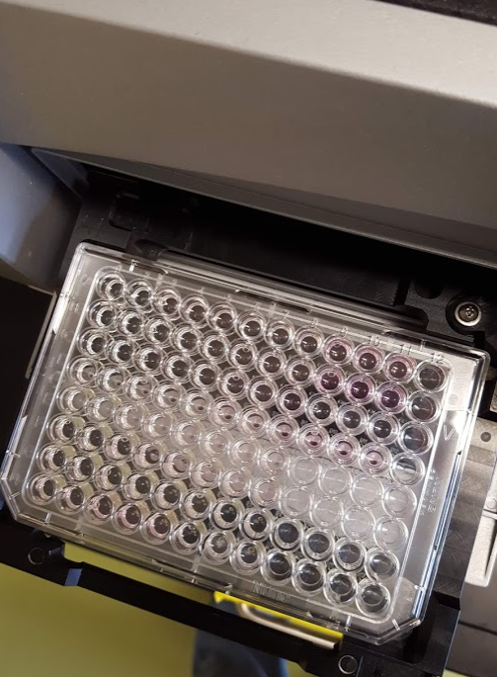

ADAC Program Year 8 Annual Meeting
Progress in meeting research methods, Phase 2
Phase 2 (in progress): physiological and biochemical assays
  Hydrogen peroxide formation in hemolymph
  RNA:DNA ratio in mantle
  Cytochrome P450 in digestive gland
  Heat Shock Protein in gill
  Superoxide dismutase in digestive gland
  Micronuclei in gill
  TBARS assay from gills
  ATP/ADP ratio from mantle
  Caspase 3/7 from gills
  Perform Statistical Analysis

Slide 11
ADAC Program Year 8 Annual Meeting
Progress on Milestones – Phase 2
Upon completion of Phase 1, team member Counihan (ASLC) will complete the following analyses (anticipating 1-2 will be complete in ADAC Program Year 5 and 3-6 will complete in ADAC Program Year 6):
  Hydrogen peroxide formation in hemolymph
  RNA:DNA ratio in mantle
  Cytochrome P450 in digestive gland
  Heat Shock Protein in gill
  Superoxide dismutase in digestive gland
  Micronuclei in gill
Upon completion of Phase 1, team member McGill (UAA) will
complete the following analyses (anticipating will be complete in
ADAC Program Year 6):
  TBARS assay
  ATP/ADP ratio
  Caspase 3/7
Completed
Completed
Completed
Completed
Completed
Completed
Completed
Completed
Completed
9 analyses x 750 mussels = 6,750 samples to process!

Slide 12
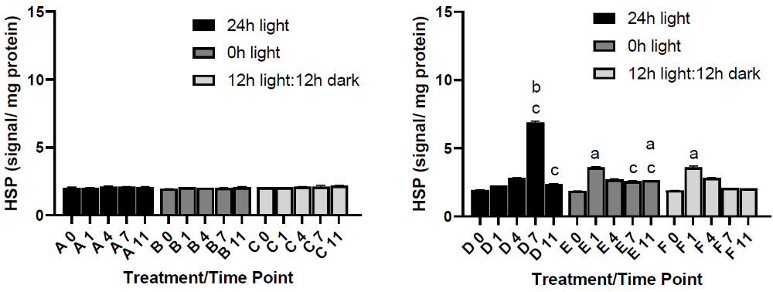
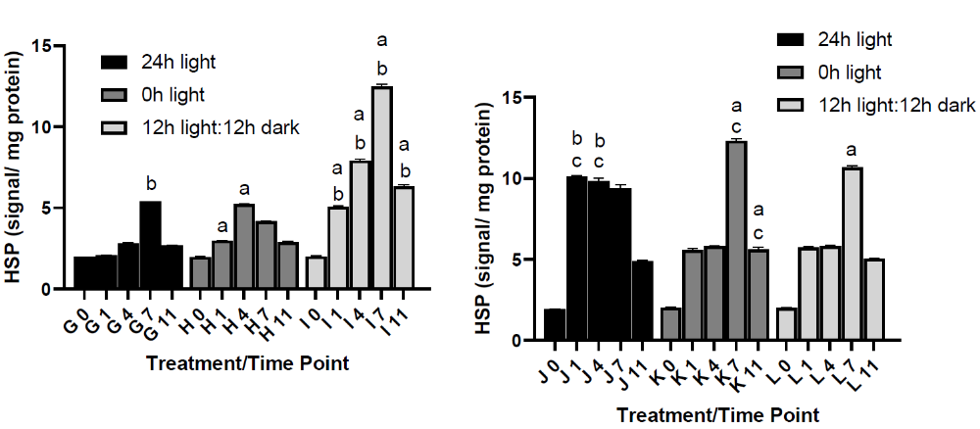
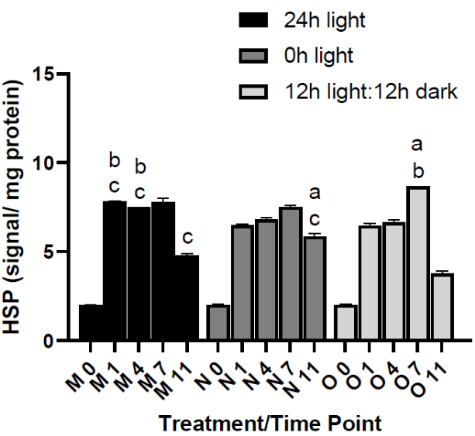
ADAC Program Year 8 Annual Meeting
Control
Oil
Heat Shock Protein (HSP)
General stress responses to contaminant exposure can be evaluated by measuring heat shock protein 40 (HSP40)
Dispersant
Dispersed Oil
Burned Oil

Slide 13
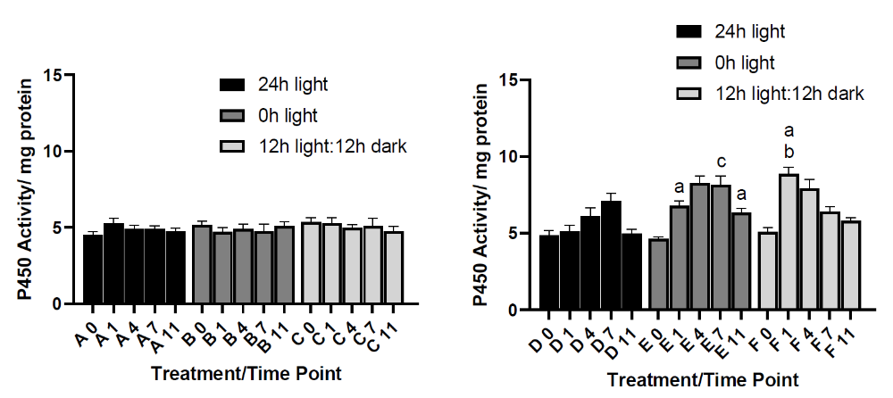
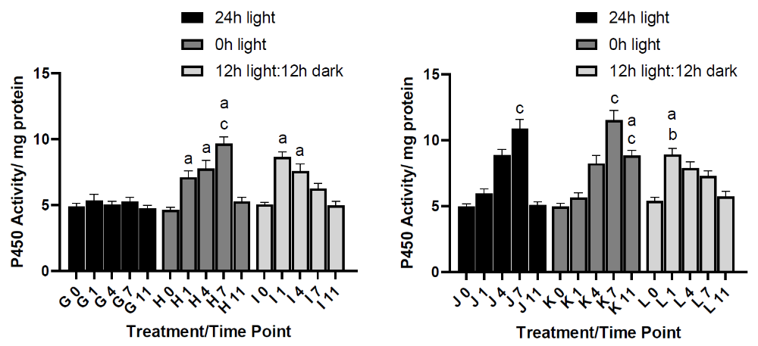
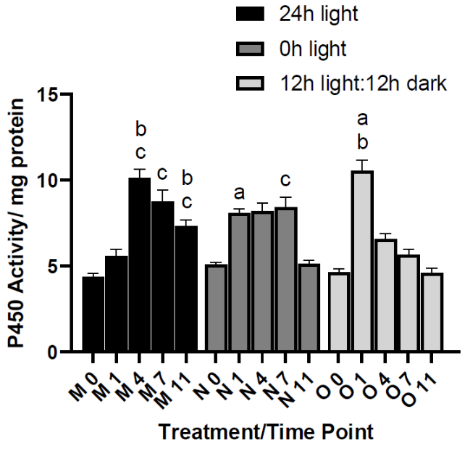
ADAC Program Year 8 Annual Meeting
Control
Oil
Cytochrome P450
Enzyme that catalyzes reactions involving PAHs and other xenobiotics and can indicate hydrocarbon exposure
Dispersant
Dispersed Oil
Burned Oil

Slide 14
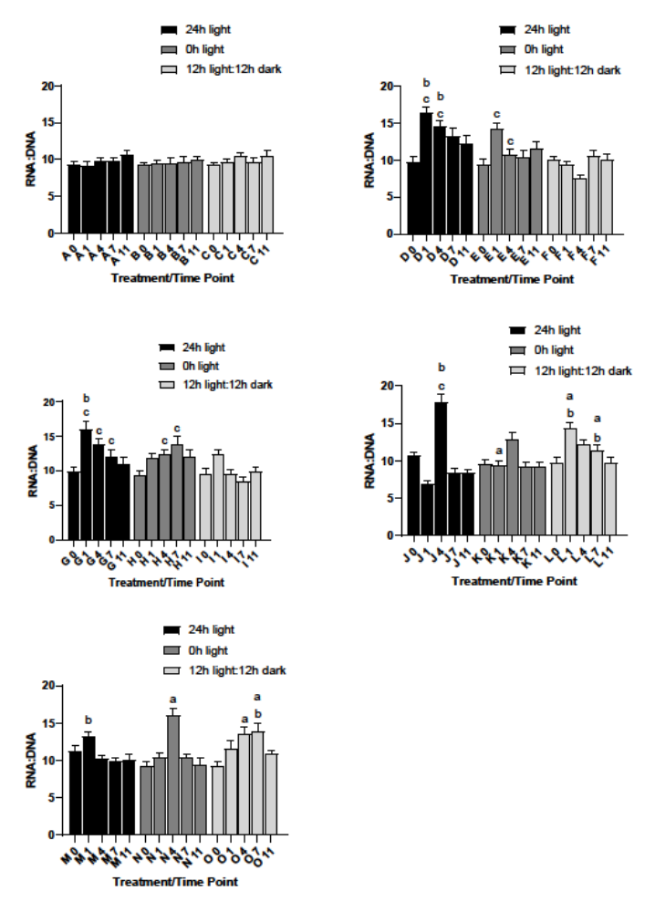
ADAC Program Year 8 Annual Meeting
Control
Oil
RNA : DNA
can be used to determine the metabolic condition of mussels as RNA fluctuates in response to conditions
Dispersant
Dispersed Oil
Burned Oil

Slide 15
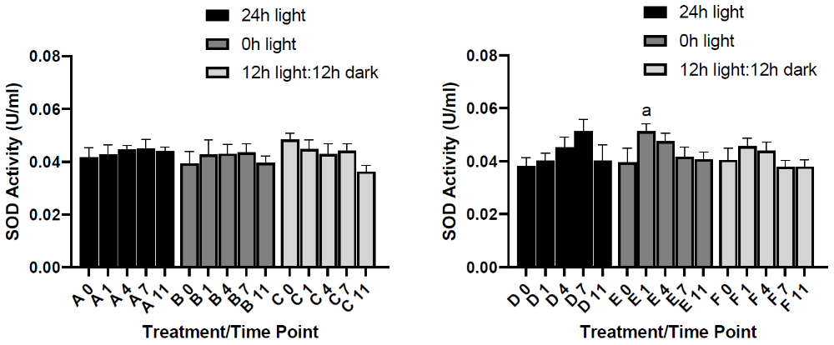
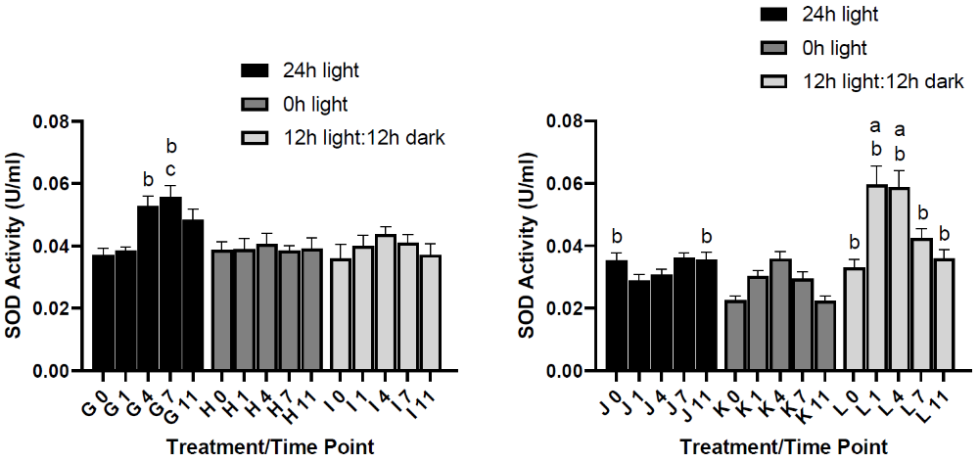
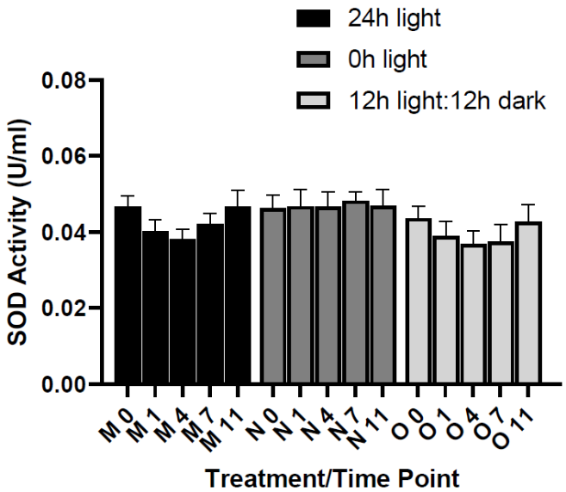
ADAC Program Year 8 Annual Meeting
Control
Oil
Superoxide dismutase (SOD)
Antioxidant activity. Evaluates oxidative damage due to the release of reactive oxygen species. Higher ROS is linked to oxidative damage in DNA, protein and lipids. damage
Dispersant
Dispersed Oil
Burned Oil

Slide 16
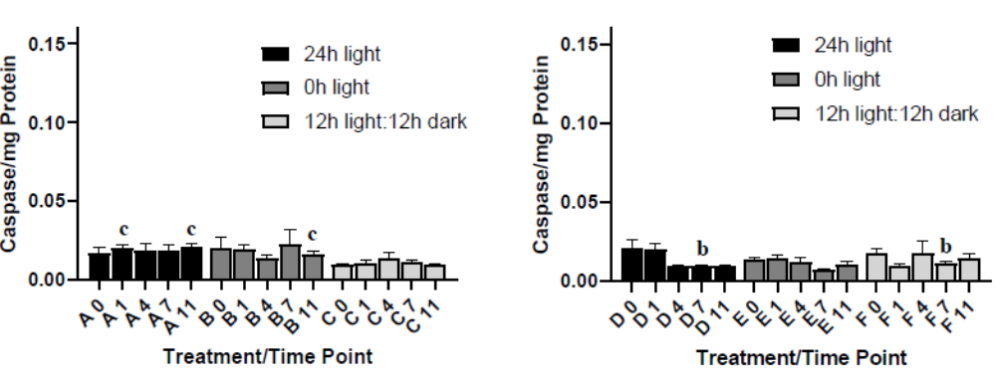
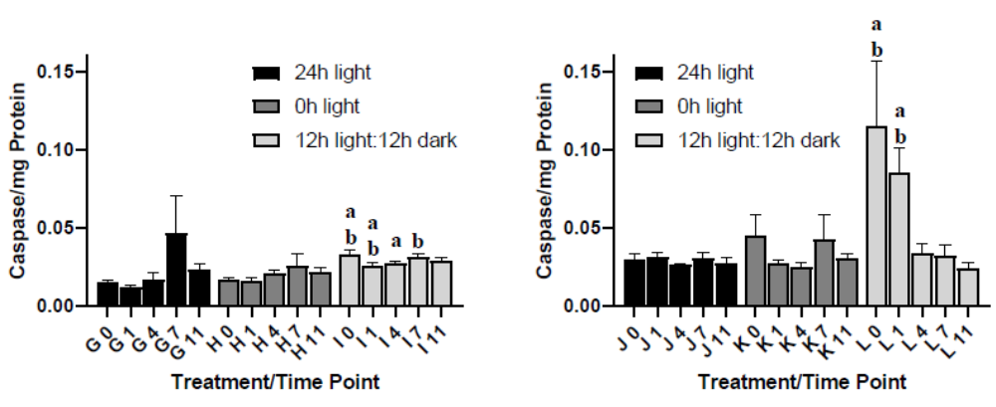
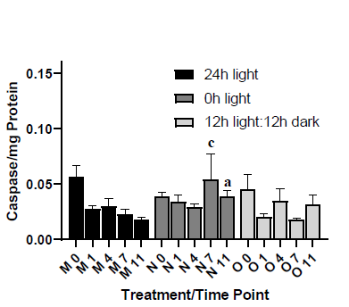
ADAC Program Year 8 Annual Meeting
Control
Oil
Caspace activity
Cell apoptosis. Programmed cell death, occurs throughout life to maintain cell homeostasis. Activation indicates upregulation of this process.
Dispersant
Dispersed Oil
Burned Oil

Slide 17
ADAC Program Year 8 Annual Meeting
Significant differences observed between the same treatments exposed to the three UV light conditions.
  Mussels exposed to oil or dispersant had the most physiological impacts in 24h and 0h light
  Musssels in dispersed oil and burned oil had more physiological effects in 24h and 12h light
  12h dark conditions.
Numerous significant differences also occurred between different treatments in the same UV lighting
  Dispersed oil generally elicited the strongest responses from the, mussels regardless of light conditions.
Significant differences between time points in each treatment.
  Physiological responses reached a peak at earlier time points in treatments exposed to 12h light: 12h dark UV conditions, while treatments exposed to 0h and 24h UV light peaked at later time points.

Slide 18
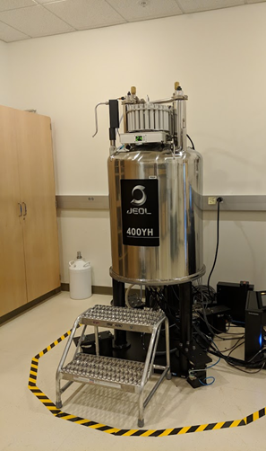
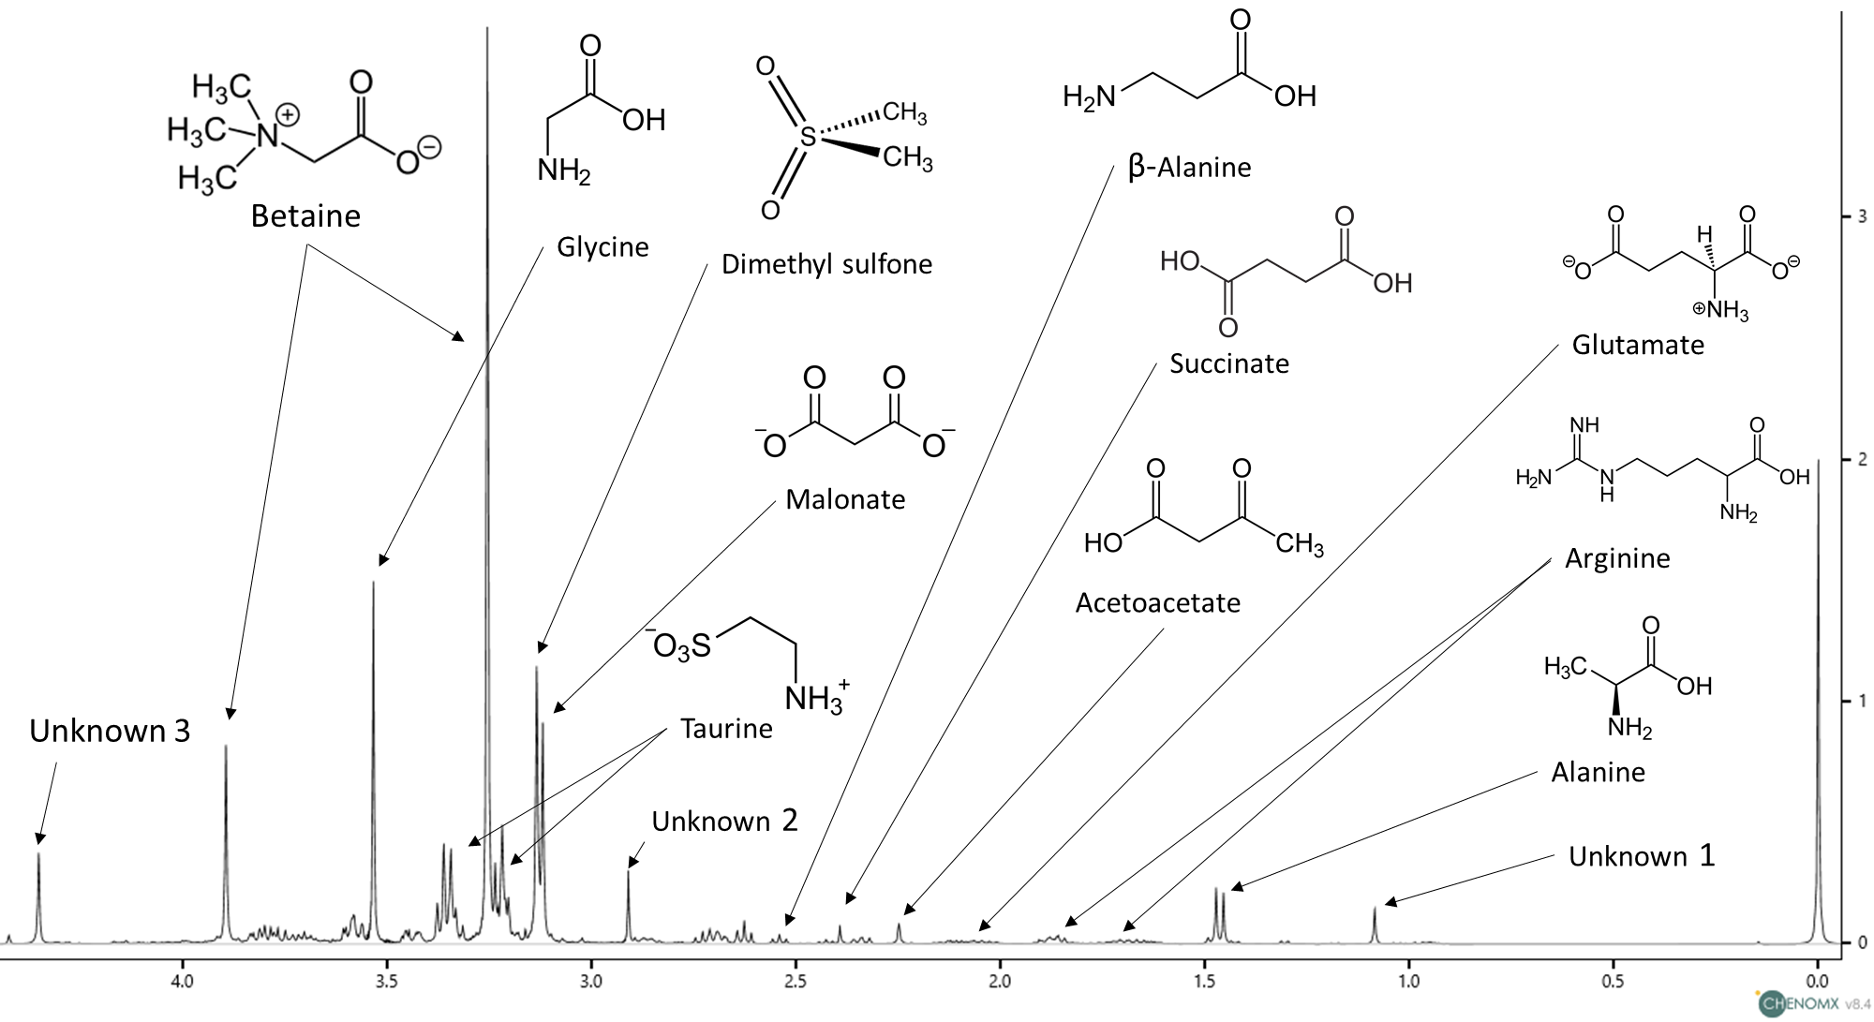
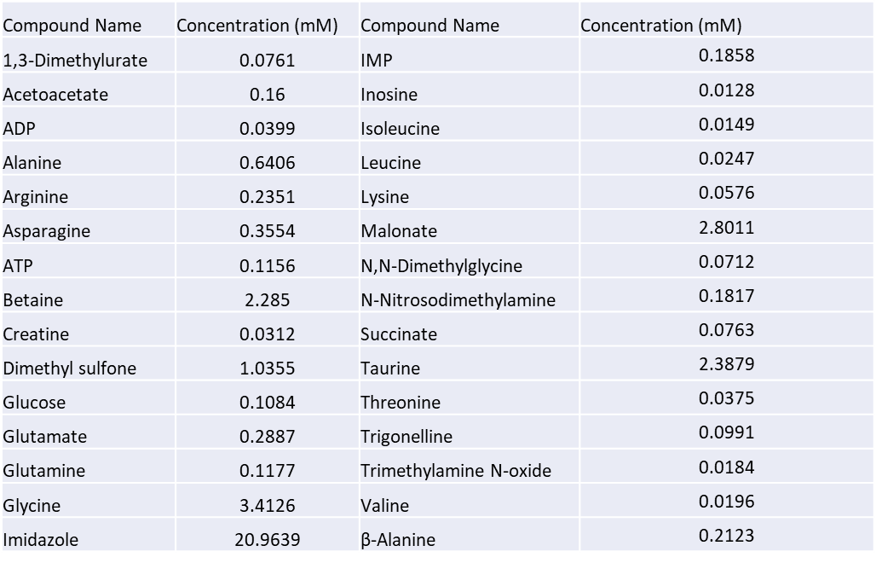
ADAC Program Year 8 Annual Meeting
Arctic Mussels Phase 3: progress in meeting research methods
Metabolomics analysis
  extract metabolites
  obtain spectra using 1H NMR 400MHz
  identify peaks using Chenomx software
  statistical anaylsis using PLS toolbox and R

Slide 19
Arctic Mussels Phase 3: Metabolomics
ADAC Program Year 8 Annual Meeting
Metrics for Phase 3:
Task A: Documentation of NMR spectra from tissue extracts.
Task B: Using NMR spectra, identify small molecule metabolites present in tissues based on database matches.
Task C: Statistically compare differences in metabolite profiles between treatments, across time, and between individuals. Tomco to evaluate and quality control the data.
Complete
Complete
Complete

Slide 20
Arctic Mussels Phase 3: Metabolomics
ADAC Program Year 8 Annual Meeting
Milestones for Phase 3:
Metabolites will be extracted from tissues and archived
NMR spectral data will be acquired at the University of Alaska Anchorage NMR facility
Chemical constituencies that correspond to primary metabolites (polar and nonpolar) found in the Human Metabolome Database will be identified
Concentrations of the identified metabolites will be determined
Multivariate statistical analysis (PCA) will be performed on binned NMR spectra (i.e. unsupervised metabolomics)
Complete
Complete
Complete
Complete
Complete

Slide 21
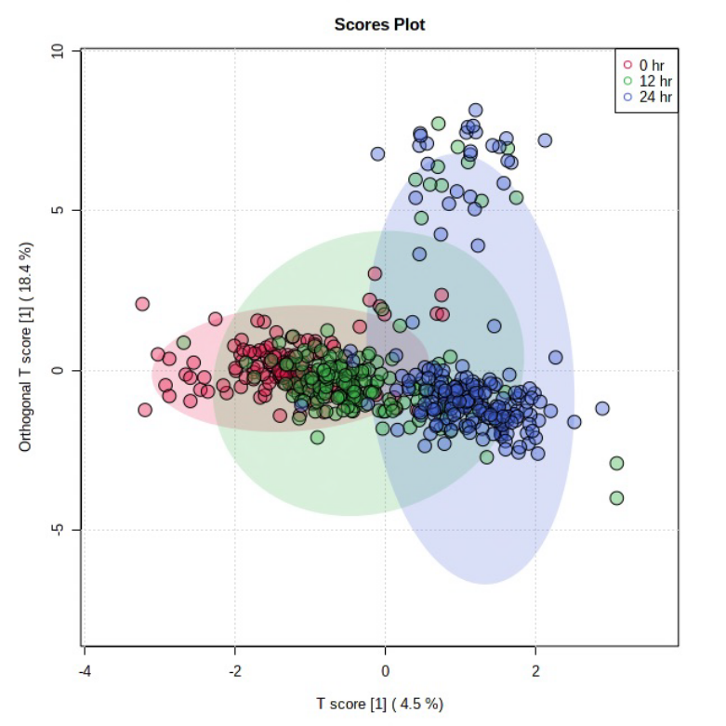
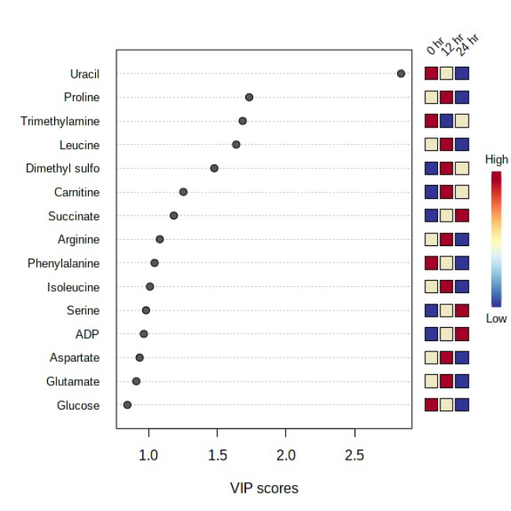
ADAC Program Year 8 Annual Meeting
Results: Metabolomics – All treatments, all light conditions, all time points
Classifier: Photoperiod (light exposure)
Each data point represents all the metabolites found in a single individual.
Differences between 0 & 24 hr, while 12 hr is intermediary

Slide 22
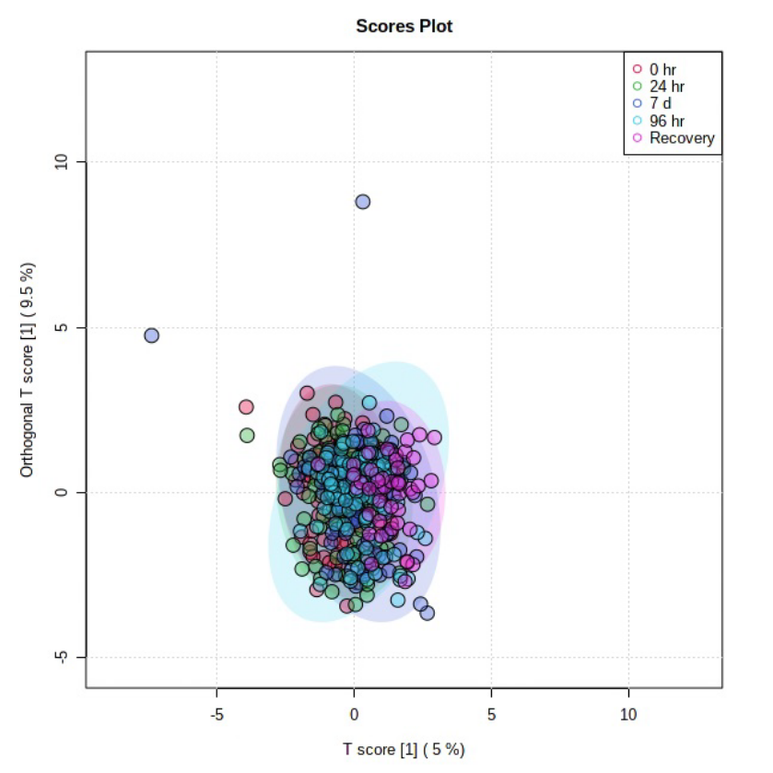
ADAC Program Year 8 Annual Meeting
Results: Metabolomics – All treatments, all light conditions, all time points
Classifier: Exposure duration (time)
Each data point represents all the metabolites found in a single individual.
No difference between the 5 time points

Slide 23
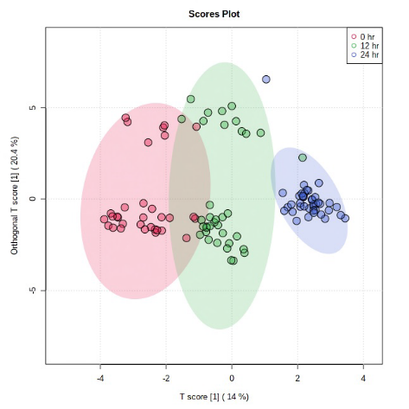
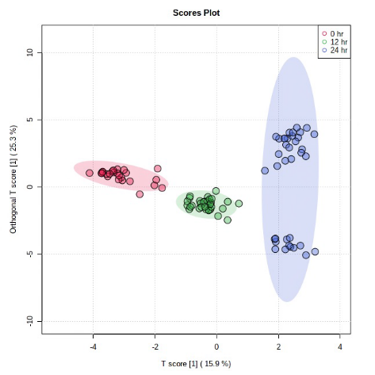
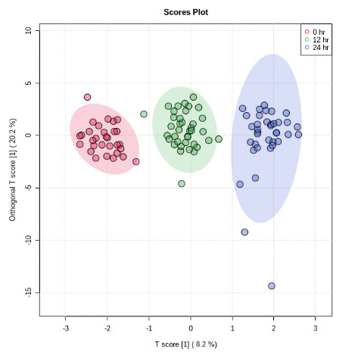
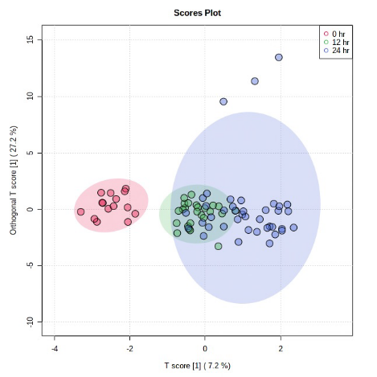
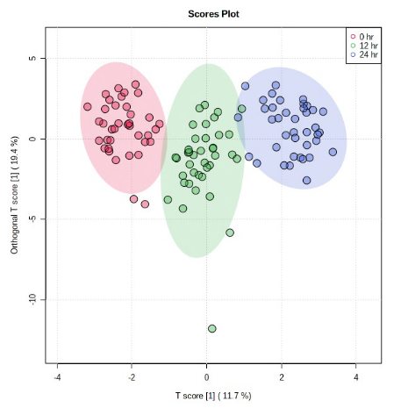
ADAC Program Year 8 Annual Meeting
Results: Metabolomics –All light conditions, all time points, individual examination of treatment
Classifier: Photoperiod (light exposure)
Each data point represents all the metabolites found in a single individual.
Differences between photoperiod for each treatment
Control
Oil
Dispersant
Dispersed Oil
Burned Oil

Slide 24
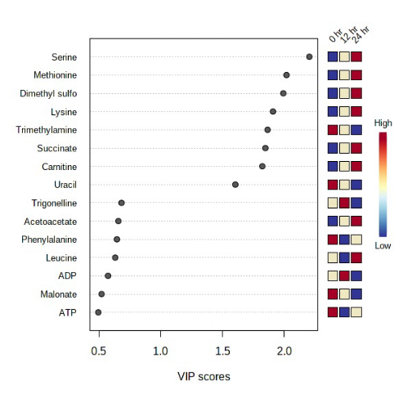
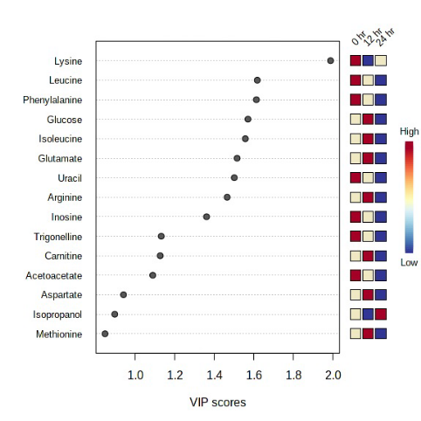
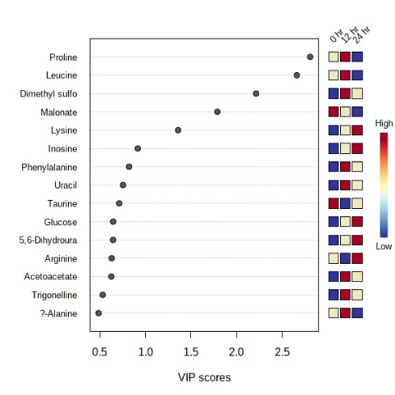
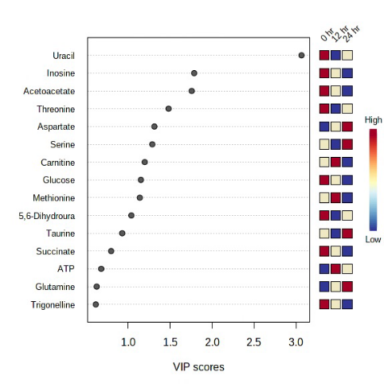
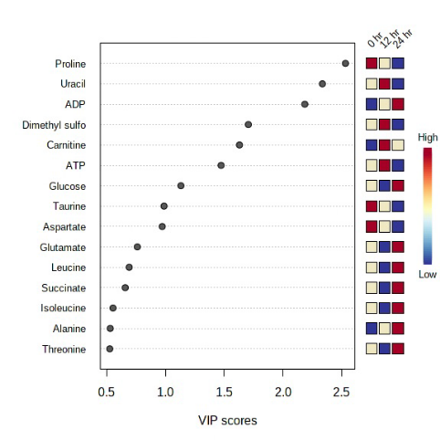
ADAC Program Year 8 Annual Meeting
Results: Metabolomics –All light conditions, all time points, individual examination of treatment
Classifier: Photoperiod (light exposure)
VIP Scores.
Different metabolites drive the observed variation between treatments
Control
Oil
Dispersant
Dispersed Oil
Burned Oil

Slide 25
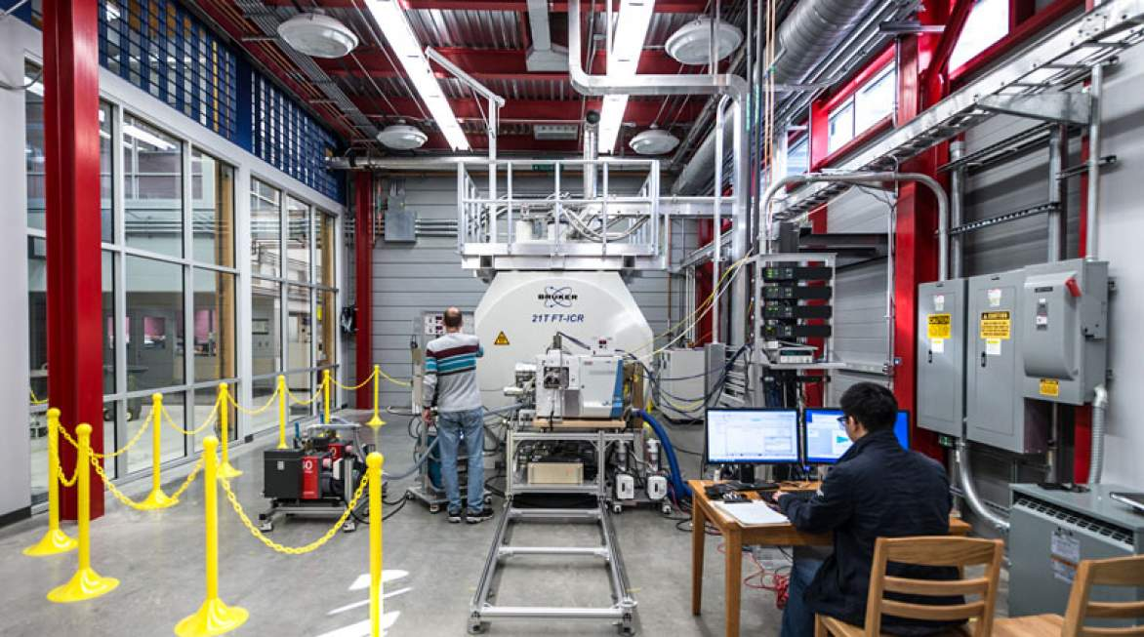
ADAC Program Year 8 Annual Meeting
Arctic Mussels Phase 4: Progress in meeting research methods
Phase 4: Profiling chemical constituencies of water-accommodated petroleum and photo-degraded petroleum
  Dissolved Organic Carbon (DOC) Analyses
  Optical Analyses
  Fourier Transform Ion Cyclotron Mass Spectrometry
(McKenna et al. 2013)

Slide 26
ADAC Program Year 8 Annual Meeting
Arctic Mussels Phase 4: Metrics
Completed
Task A: Obtain necessary instrument time permissions for 180 FT-ICR MS samples at the National High Magnetic Field Laboratory.
Task B: Document dissolved organic carbon concentrations in water samples
Task C: Document spectrofluorescence and FT-ICR MS data from water samples.
Task D: Statistically compare differences in DOC, spectrofluorescence and FT-ICR MS data between treatments, across time, and between replicates. Zito to evaluate and quality control the data.
Completed
Completed
Completed

Slide 27
ADAC Program Year 8 Annual Meeting
Arctic Mussels Phase 4: Milestones
Phase 4: Chemical Analyses. Upon completion of Phase 1 and once water samples have been received, Team member Zito will analyze the chemical composition of aqueous-phase hydrocarbons at the University of New Orleans.
Milestones anticipated:
The dissolved organic carbon (DOC) content of each water sample will be calculated
The three-dimensional fluorescence character of each water sample will be determined
Water samples will be pre-concentrated for FT-ICR Mass Spectra collection
FT-ICR MS data will be collected at the National High Field Magnetic Laboratory in Tallahassee FL

Slide 28
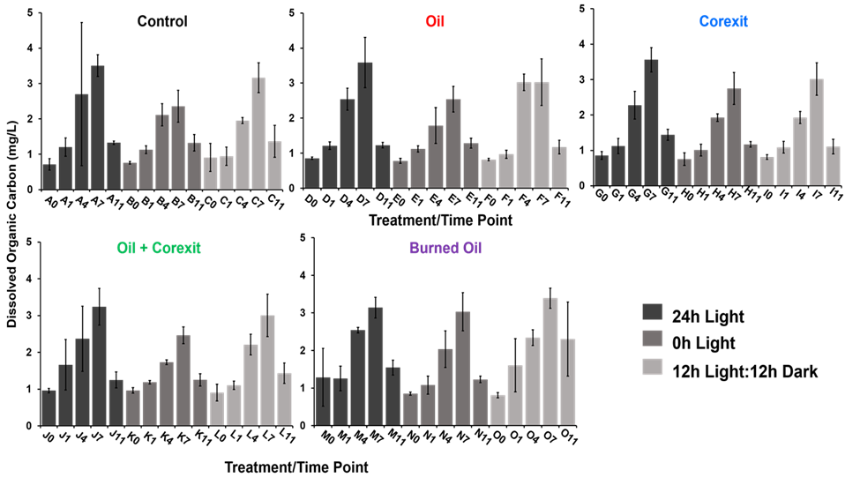
ADAC Program Year 8 Annual Meeting
Dissolved Organic Carbon
Measures the total amount of all carbon species dissolved in water

Slide 29
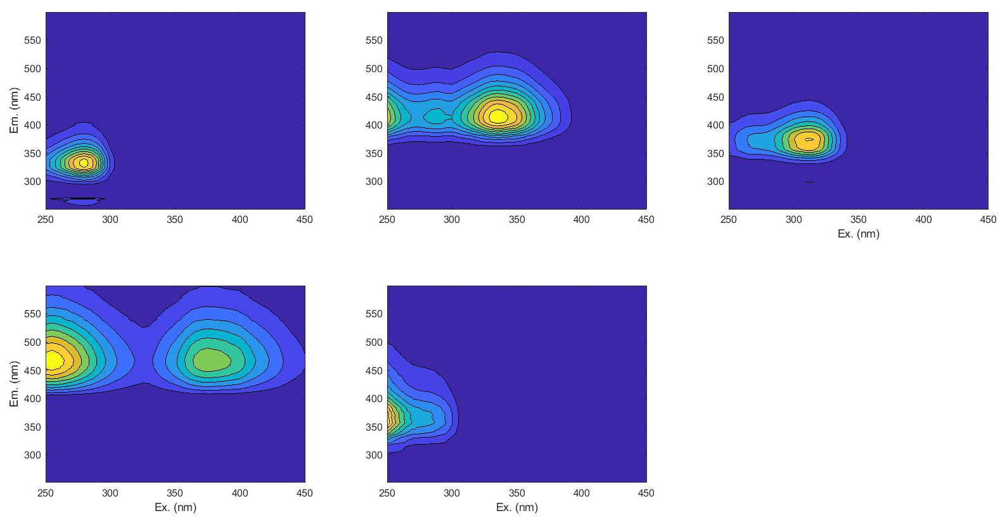
ADAC Program Year 8 Annual Meeting
Component 1
Component 2
Component 3
>95% Database match with petroleum-derived dissolved organic material
Component 5
Fluorescence analysis:
PARAFAC 5 components
Component 4

Slide 30
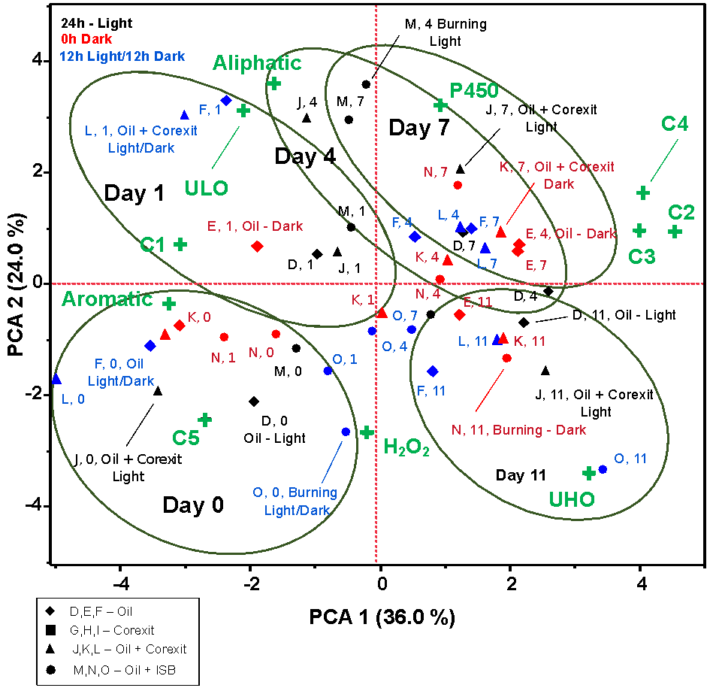
ADAC Program Year 8 Annual Meeting
Ultrahigh Resolution Mass Spectrometry

Slide 31
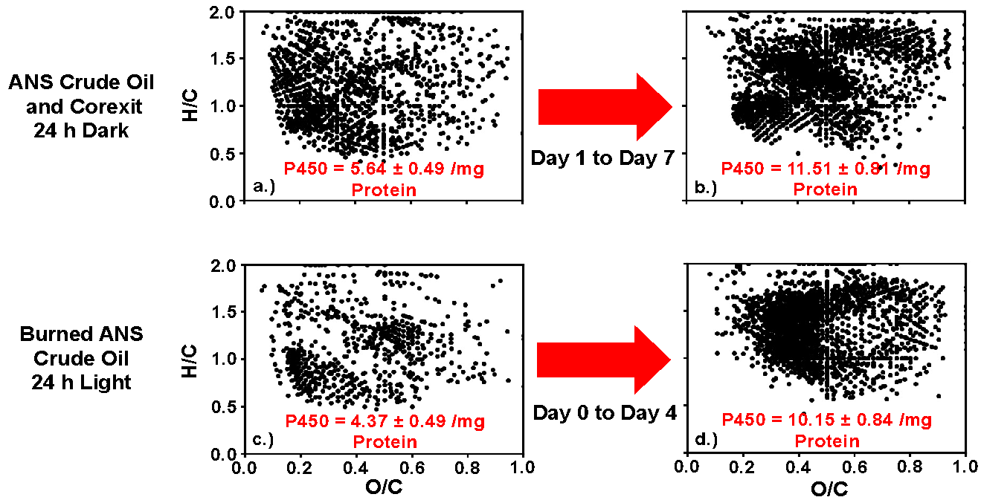
ADAC Program Year 8 Annual Meeting
van Krevelen subtraction plots of treatments with relatively high and low cytochrome P450 activity.

Slide 32
ADAC Program Year 8 Annual Meeting
Arctic Mussels Phase 5: Progress in meeting research methods
Synthesize data and prepare knowledge products
Knowledge product was submitted to USCG on December 15th, 2021
Summarized findings and identified appropriate peer-review journals for submission.
All Team members prepared manuscript and submitted to peer-reviewed scientific journal Aquatic Toxicology
Team members facilitated graduate student mentorship outcome (completed M.S. Thesis)

Slide 33
Arctic Mussels: Schedule and Metrics
ADAC Program Year 8 Annual Meeting
Current year research schedule and milestones:
  Phase 1 – Complete
  Phase 2 – Complete
  Phase 3 – Complete
  Phase 4 – Complete
  Phase 5 – Complete
Current year metrics:
Progress on Phase 5

Slide 34
Arctic Mussels: Key Accomplishments
ADAC Program Year 8 Annual Meeting
Key accomplishments of the project:
  Permits obtained
  Engagement with Project Champion
  Exposure chamber build-out
  Mussel harvest
  Exposures conducted
  Tissues dissected
  Samples distributed
  Toxicity data collected and analyzed
  Water samples processed
  Students trained
  Knowledge product created
  Peer-reviewed scientific journal manuscript submitted

Slide 35
Arctic Mussels: Key Findings
ADAC Program Year 8 Annual Meeting
Sunlight exposure significantly affects the toxicity of crude oil, dispersed oil, and burned oil to marine biota
  Most significant = HSP, CP450, Metabolic phenotypes
Timing/magnitude affected both by photoperiod and treatment
Dispersed oil in general = highest toxicity (but burned oil significant too)
More streamlined water chemistry measures of oxidized water-soluble oil are a significant challenge and a priority research need
Mussels are an excellent test organism for this line of study.

Slide 36
Arctic Mussels: Transition Plans
ADAC Program Year 8 Annual Meeting
Future integration with copepods team for knowledge product?
Translating toxicity data generated into policy decisions and criteria for recovering spilled oil requires not only controlled experiments conducted under simulated realistic scenarios and complex data analysis; it also requires a “global perspective” cost/benefit weighing.

Slide 37
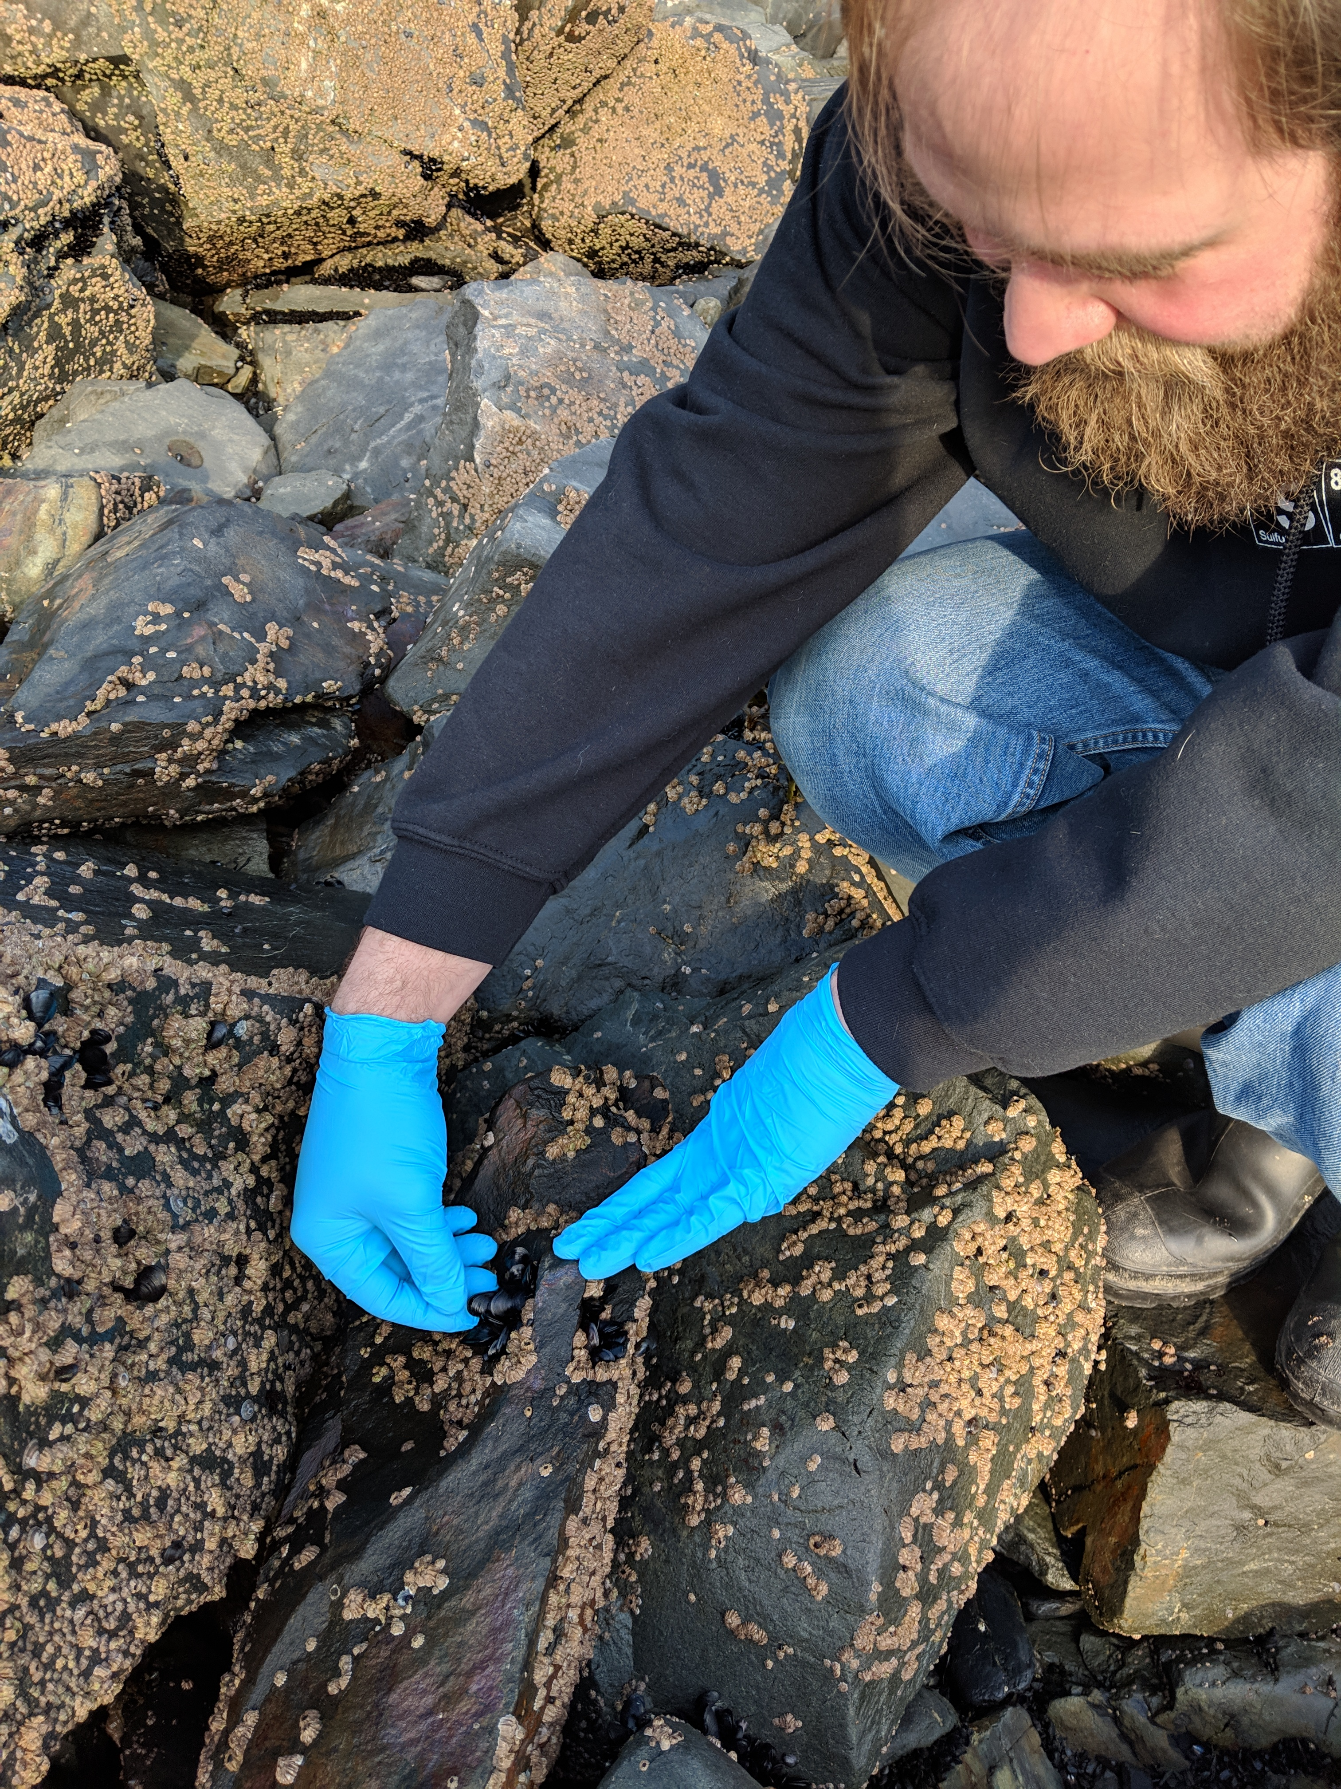
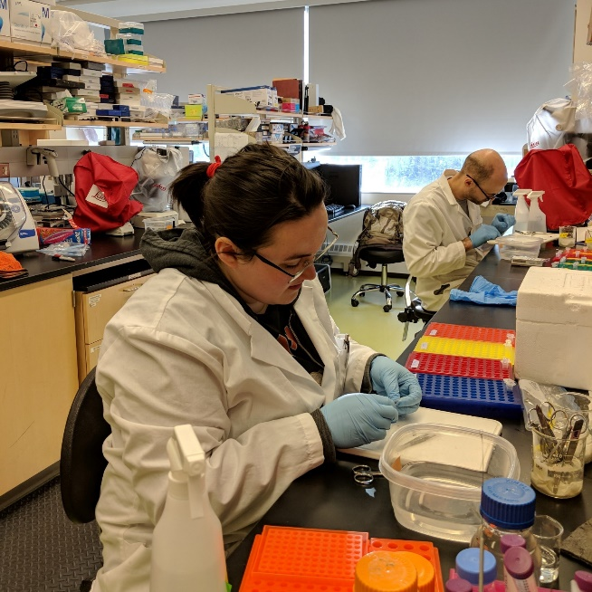
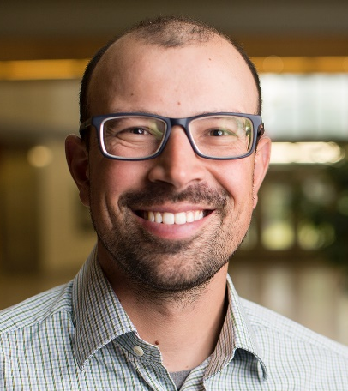
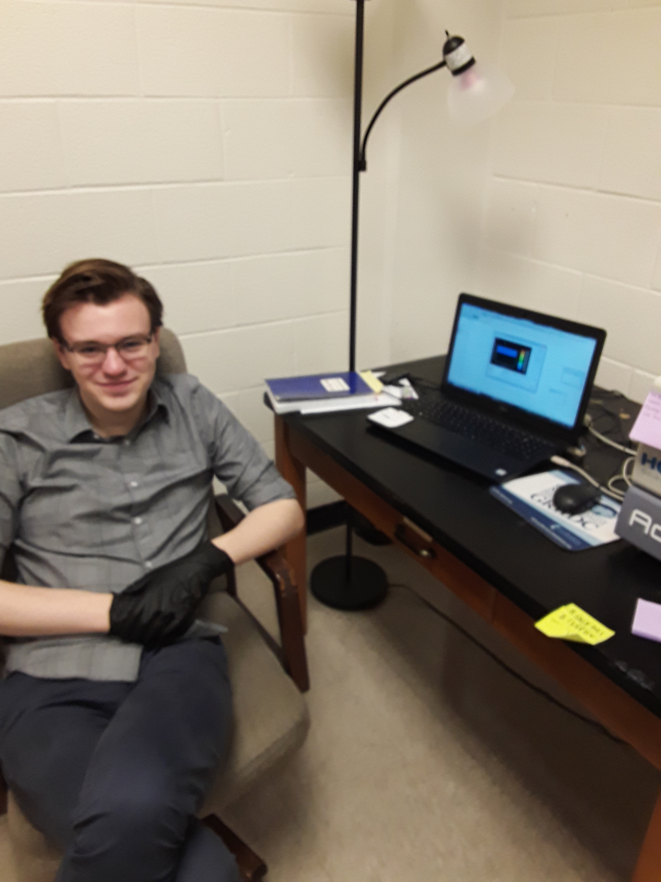
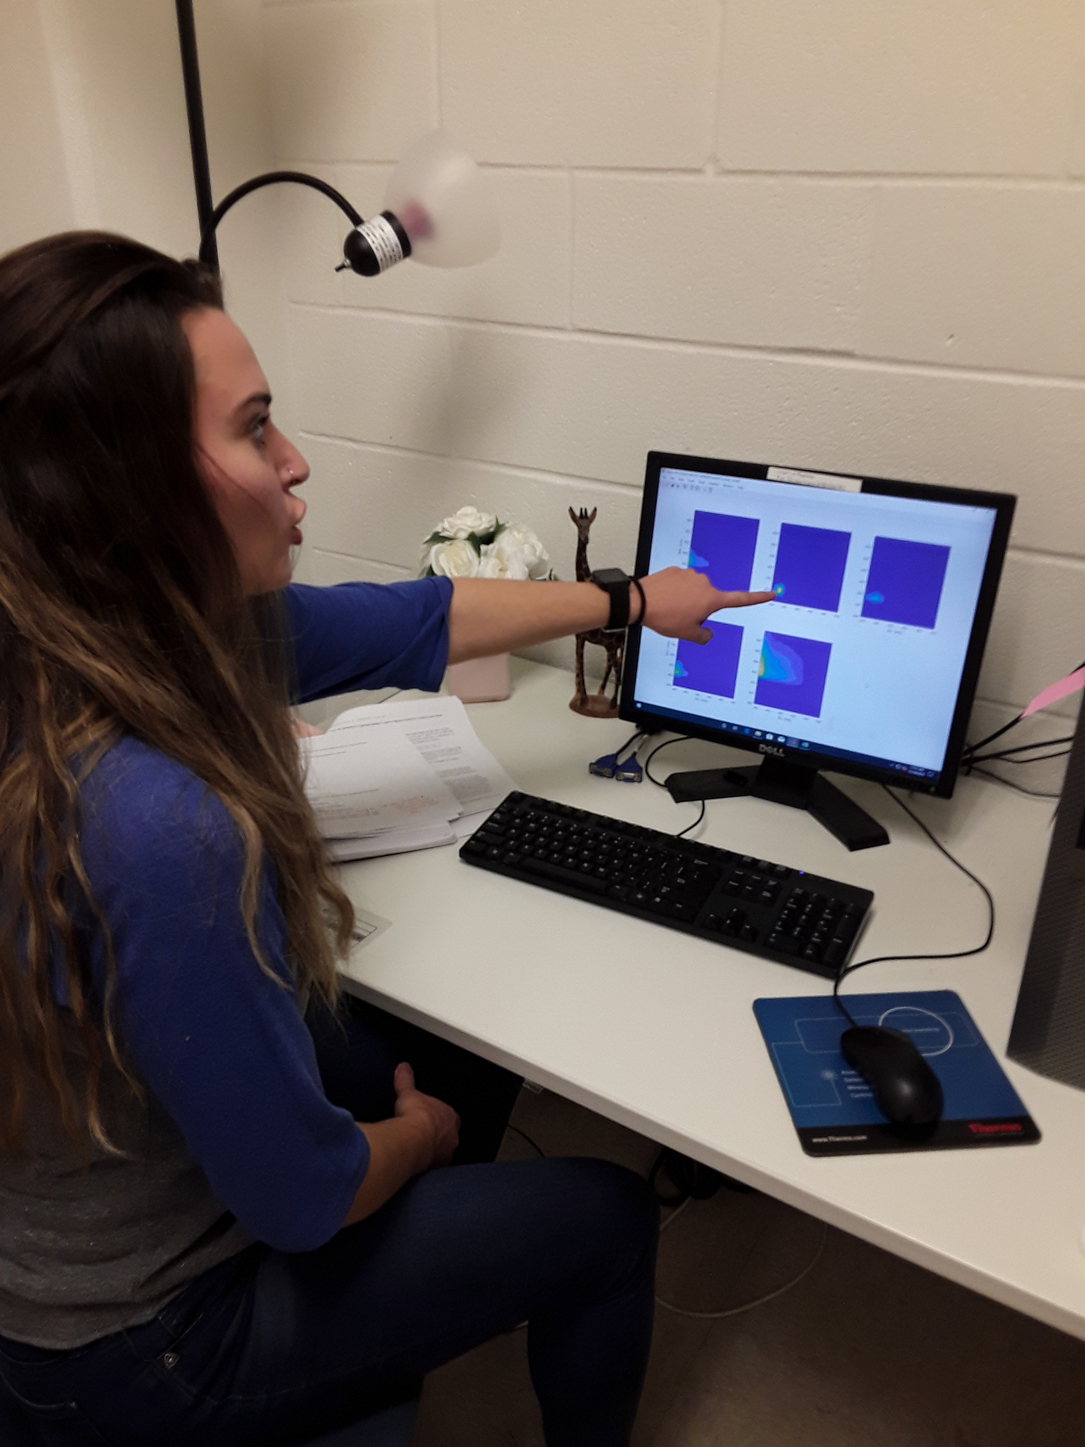
Ready for questions…Thank you!
ADAC Program Year 8 Annual Meeting
Notes:
Thank you for the gift of your time and attention.

